Slide 1
Lending Club Case Study
Exploratory Data Analysis
Supriya
Tamilarasan

Slide 2
Content
Problem Statement
Data Summary
Data Cleaning
Data Conversions
Derived Columns
Dropping or Imputing Rows
Outliers
Univariate Analysis
Bivariate Analysis
Conclusion

Slide 3

Problem Statement
Problem: You work for a consumer finance company specializing in lending various types of loans to urban customers. When the company receives a loan application, it must decide whether to approve the loan based on the applicant’s profile. There are two types of risks associated with the bank’s decision:
If the applicant is likely to repay the loan, not approving the loan results in a loss of business for the company.
If the applicant is not likely to repay the loan (i.e., they are likely to default), approving the loan may lead to a financial loss for the company.
Objective: Use Exploratory Data Analysis (EDA) to understand how consumer attributes and loan attributes influence the tendency of default.
Constraints: When a person applies for a loan, there are two types of decisions that the company can make:
Loan accepted: If the company approves the loan, there are three possible scenarios:
Fully paid: The applicant has fully paid the loan (both the principal and the interest).
Current: The applicant is in the process of paying the installments, i.e., the tenure of the loan is not yet completed. These candidates are not labeled as ‘defaulted’.
Charged-off: The applicant has not paid the installments in due time for a long period, i.e., they have defaulted on the loan.
Loan rejected: The company rejected the loan (because the candidate did not meet their requirements, etc.). Since the loan was rejected, there is no transactional history of those applicants with the company, and thus this data is not available in the dataset.

Slide 4
Data Understanding
Loan.csv file contains 39717 rows and 111 columns.
There are two types of attributes - Loan Attributes and Customer attributes.

Slide 5

Data Cleaning
Header, Footer, and Summary Rows: No header, footer, summary, or total rows were found in the dataset.
Duplicate Rows: No duplicate rows were detected.
Rows with 'loan_status' = 'current': 1,140 rows deleted, as they do not contribute to the analysis.
Columns with Null/Blank Values: 55 columns have been removed, as they do not participate in the analysis.
Unique Columns: 'url' and 'member_id' were unique and have been deleted. The 'id' column has been retained for potential future analysis.
Text/Description: 'desc' and 'title' columns, which contain text/description values, have been dropped.
Sub-group Analysis: The analysis is limited to the 'Group' level only; hence, the sub-group has been dropped.
Behavioral Data: 21 behavioral data columns have been deleted, as they were captured based on domain knowledge and are not available during loan approval, thus not contributing to the analysis.
Columns with Unique Values: 8 columns with values of 1, indicating uniqueness, have been dropped from the analysis.
Columns with High NA Values: Two columns with more than 50% missing data (NA) have been removed.
Final Dataset: After all data cleaning processes, 38,577 rows and 20 columns remain.
Data Manipulation: For the given dataset, No further data manipulation was required for the columns essential to Exploratory Data Analysis (EDA).

Slide 6
Data Conversions
'Term' : Additional string values were trimmed from the 'term' column, which has now been converted to an integer data type.
'Int Rate' : The 'int_rate' column was converted from a string to an integer data type, with the additional '%' symbol removed.
Loan and Funded Amount : The 'loan_funded_amnt' and 'funded_amnt' columns were converted to float data types.
Decimal Precision: The columns 'loan_amnt', 'funded_amnt', 'funded_amnt_inv', 'int_rate', and 'dti' were rounded to two decimal points for consistency.
Date Conversion: The 'issue_d' column has been converted to a date type.

Slide 7
Derived Columns
Derived Columns from 'issue_d': 'issue_year' and 'issue_month' were created to facilitate further analysis.
Range Columns: Derived columns—'loan_amnt_range', 'annual_inc_range', 'int_rate_range', 'installment_range', and 'dti_range'—were created by binning continuous data into multiple categories for enhanced analysis..

Slide 8
Dropping/Inputting the rows
The 'emp_length' and 'pub_rec_bankruptcies' columns contain 2.67% and 1.80% of rows with null values, respectively. Given the small percentage of missing data, these rows can be safely removed.
Total Rows Deleted: 4.48%.

Slide 9
Outlier Treatment
Outliers were identified and removed from the following columns: 'loan_amnt', 'funded_amnt', 'funded_amnt_inv', 'int_rate', 'installment', and 'annual_inc'.
Outlier Treatment: The quantile mechanism was applied to address outliers in the above fields.

Slide 10
Univariate Analysis Outcome
Loan Amount: Higher loan amounts are associated with a higher probability of the loan being charged off. Click here for Diagram
Interest Rates: Elevated interest rates correlate with an increased likelihood of loan charge-offs. Click here for Diagram
Employee Experience: No discernible pattern was identified in the chart based on years of employee experience. Click here for Diagram
Verification Process: Surprisingly, verified applicants exhibit a higher likelihood of their loans being charged off, indicating potential discrepancies in the verification process. Click here for Diagram
Purpose: Loans to small businesses present a higher risk of being charged off, with a charge-off rate exceeding 20%. Click here for Diagram
State-Specific Risk: The states of Nevada (NV), Tennessee (TN), and Alaska (AK) are identified as riskier, with charge-off rates exceeding 20%. Click here for Diagram
Bankruptcy: Applicants with a history of bankruptcy are more likely to default on their loans. Click here for Diagram
Loan Issuance by Month: Loans issued in December, May, September, and October have a higher likelihood of being charged off. Click here for Diagram
Installment Amount: Larger installment amounts result in a greater probability of loans being charged off. Click here for Diagram
Income: Higher income levels reduce the chances of a loan being charged off. Click here for Diagram
Debt-to-Income Ratio: An increased Debt-to-Income (DTI) ratio significantly raises the likelihood of loan charge-offs. Click here for Diagram
Loan Term: Loans with a 36-month term have a lower risk of being charged off. Hence, shorter loan terms reduce the probability of default. Click here for Diagram
Loan Grades: Loans with grades G, F, and E exhibit a higher risk of being charged off. Click here for Diagram
**Refer Annexture for detailed report: Annexture

Slide 11
Bivariate Analysis

Slide 12
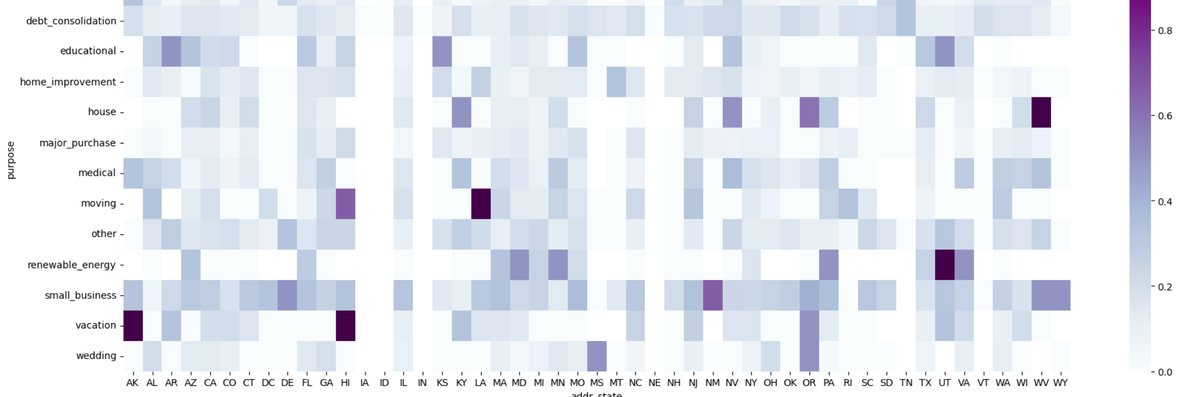
State vs Loan Purpose
The darker the intersection between a state's abbreviation (addr_state) and the purpose of the loan, the riskier the loan application. Key examples include:
Vacation Loans: High risk in AK, HI, OR
Education Loans: High risk in AR, KS, UT
Small Business Loans: High risk in DE, NM, WV
Renewable Energy Loans: High risk in UT, OR

Slide 13
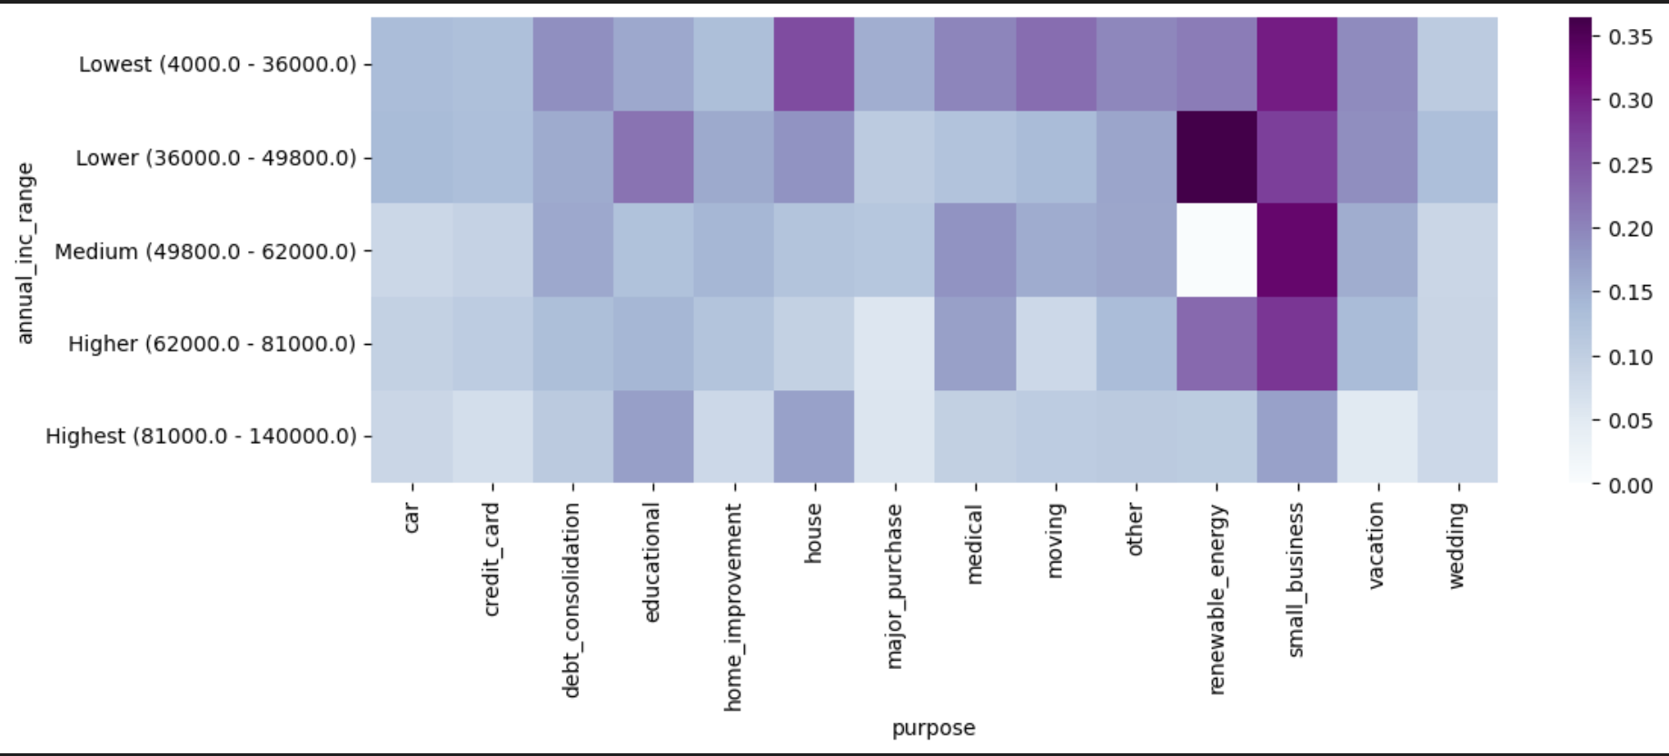
Annual Income vs Purpose
Some of the higher-risk loan applications include:
Small business loans for individuals in the lowest and middle-income brackets.
Renewable energy loans targeted at lower-income groups.

Slide 14
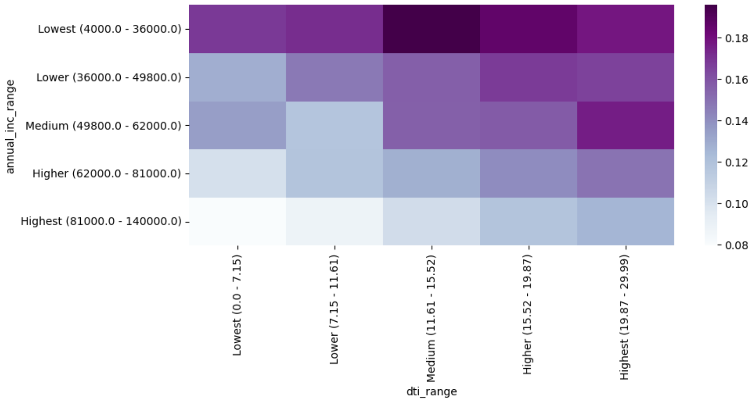
Annual Income vs debt-to-income
Medium debt-to-income group in the lowest income range poses the highest risk

Slide 15
Recommendations
Addressing Loan Defaults: Implement measures to mitigate the risk of default among individuals with annual incomes between $4,000 and $36,000, as they exhibit a higher likelihood of defaulting on loans.
Managing High Loan Amounts: Monitor and manage high loan amounts more effectively, as these are associated with increased instances of charge-offs.
Evaluating Debt-to-Income Ratios: Pay closer attention to loan applicants with high debt-to-income ratios, as they have been shown to present a greater risk.
Improving Verification Processes: Reassess and enhance the verification process, since applicants who were verified have demonstrated higher rates of charge-offs.
Assessing Bankruptcy History: Exercise caution with applicants who have a history of bankruptcy, as they are identified as higher-risk individuals.
Focusing on Specific Loan Types: Be aware that small business loans for low and medium-income groups, as well as renewable energy loans for lower-income groups, have shown a tendency for higher charge-offs.
Geographic Risk Assessment: Take note of the increased risk associated with loan applicants from Nevada (NV), Tennessee (TN), and Arkansas (AK), and adjust strategies accordingly.

Slide 16

Thank you!

Slide 17
Annexture: Univariate Analysis Report

Slide 18
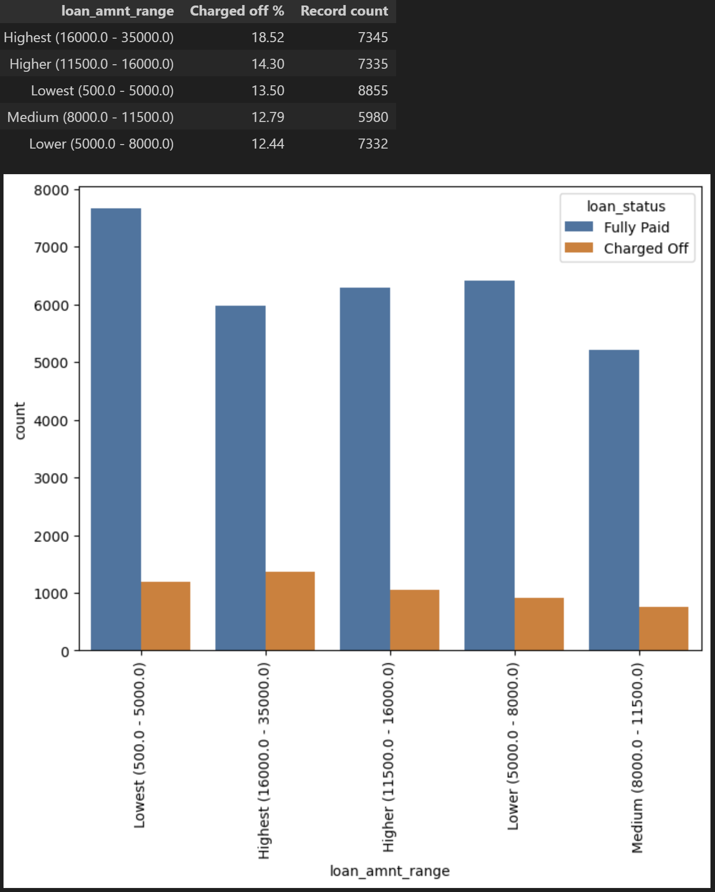
Loan Amount

Slide 19
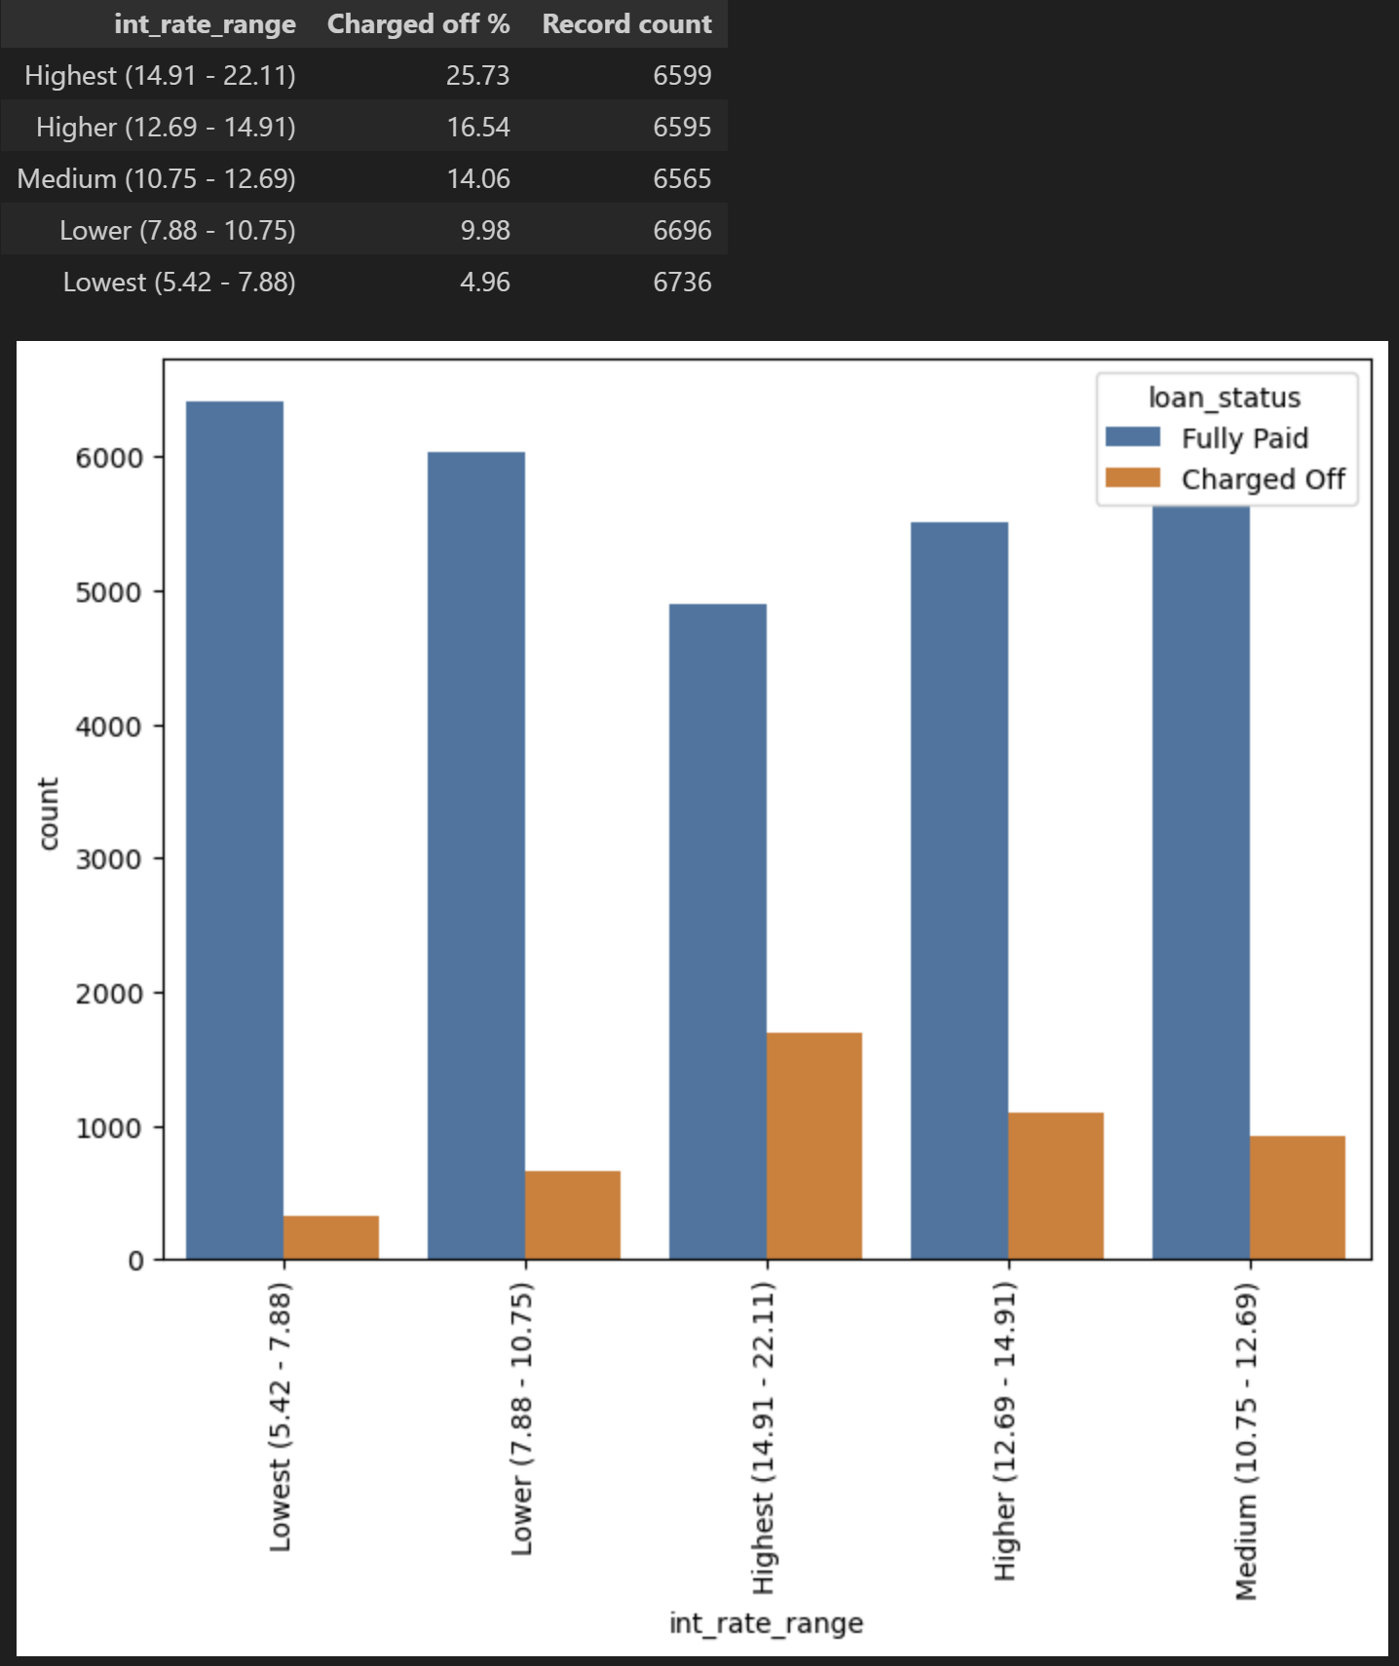
Interest Rates

Slide 20
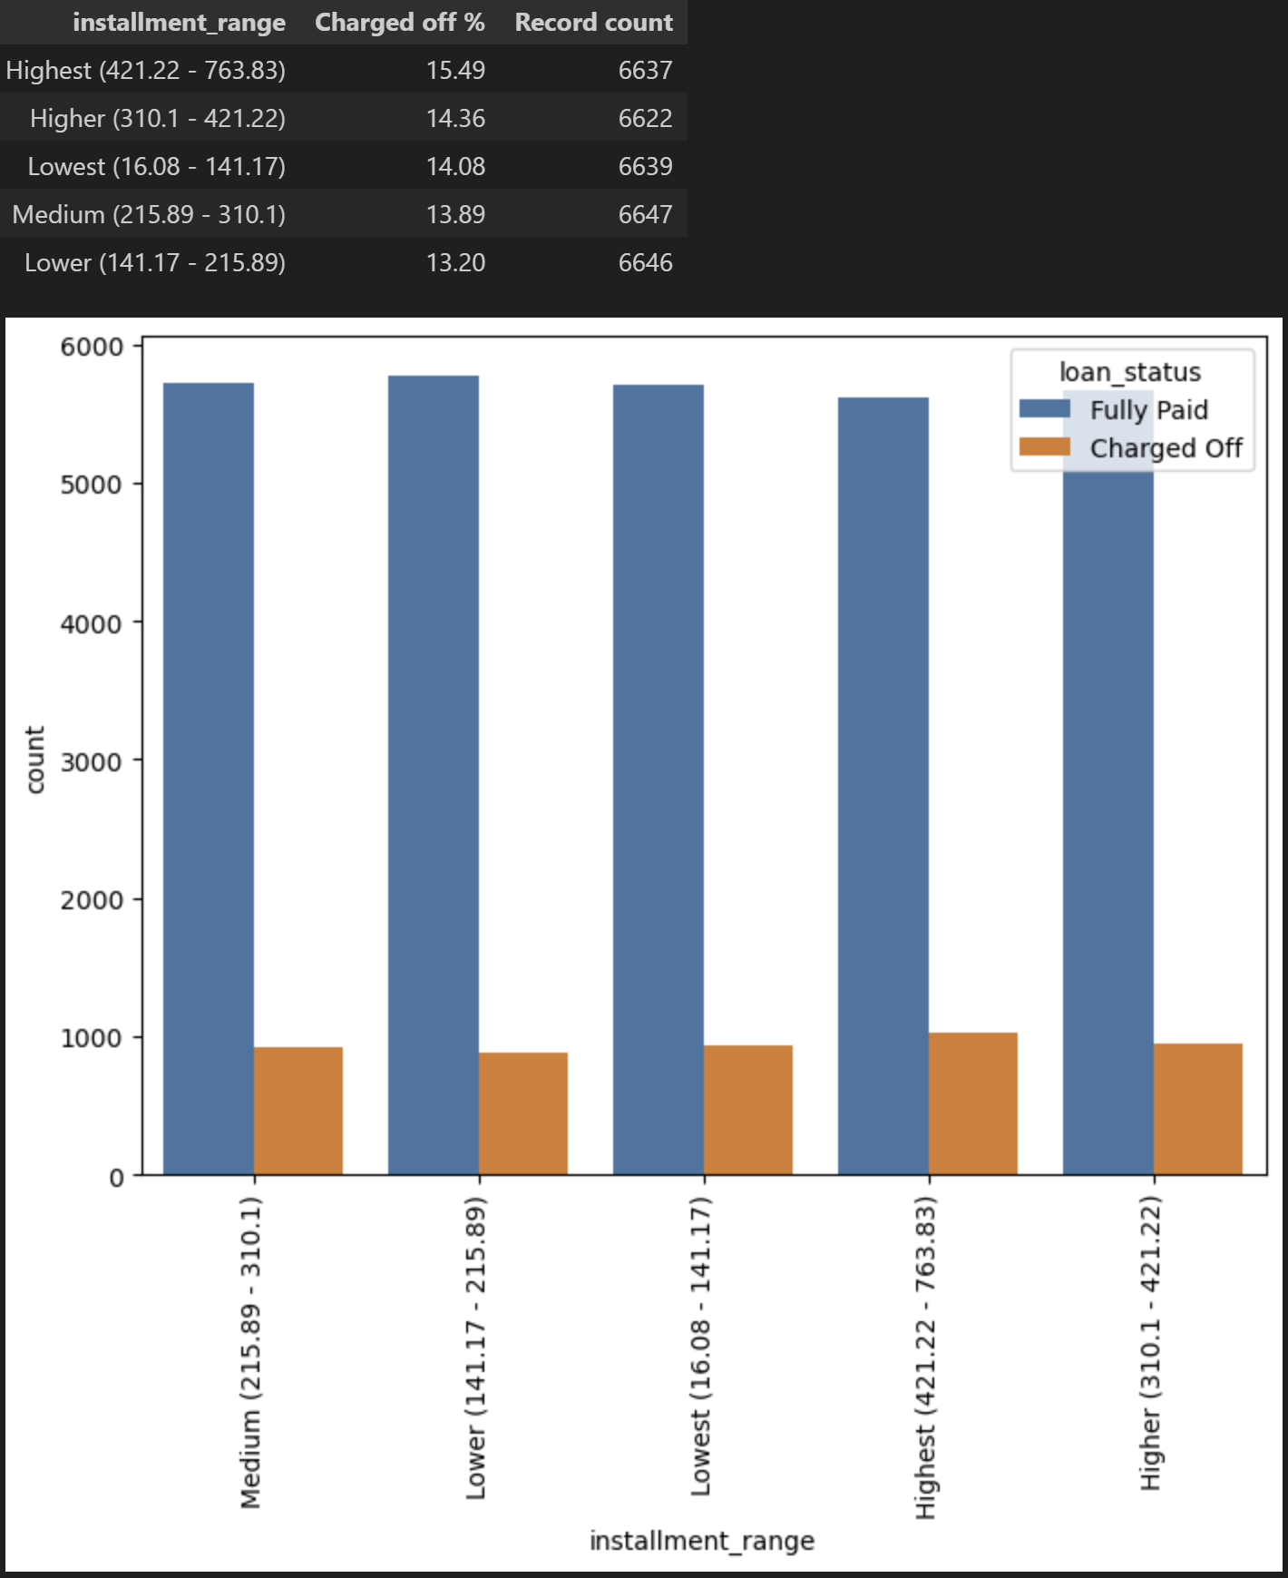
Installment Amount

Slide 21
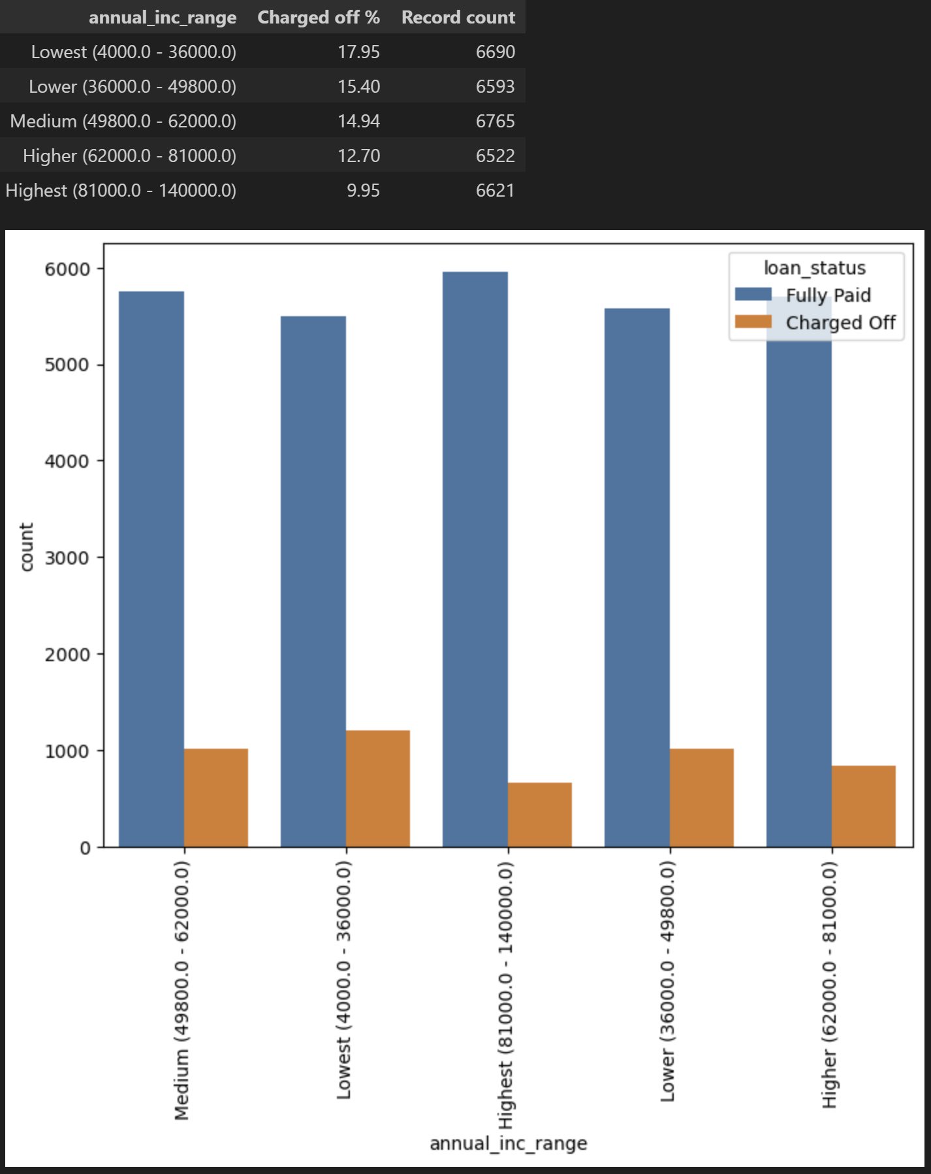
Income

Slide 22
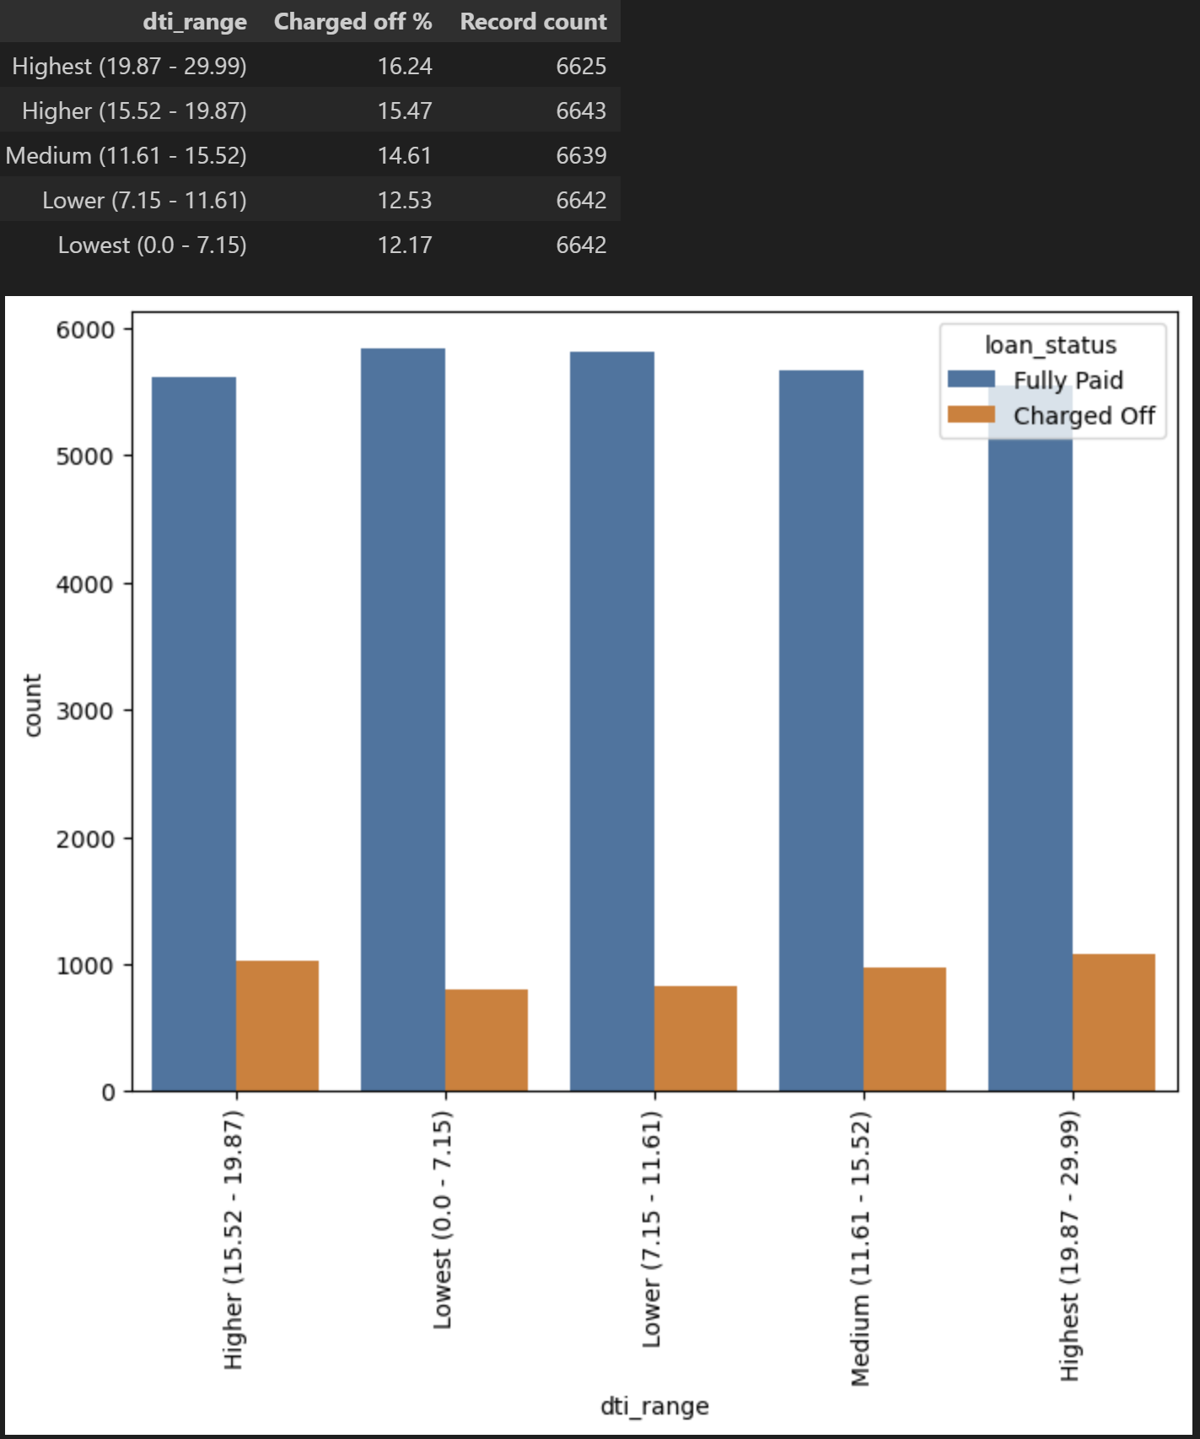
Debt-to-Income Ratio

Slide 23
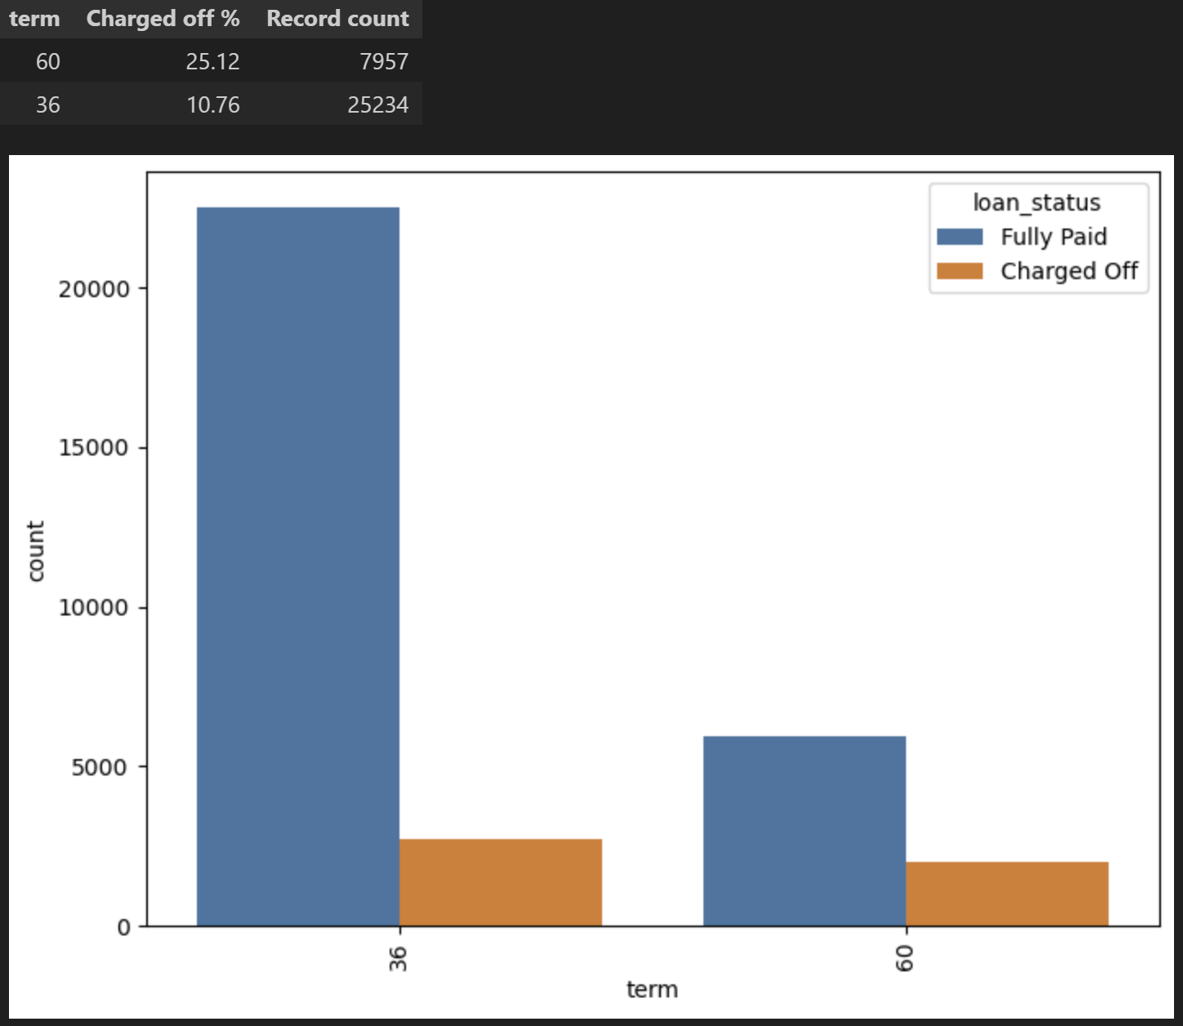
Loan Term

Slide 24
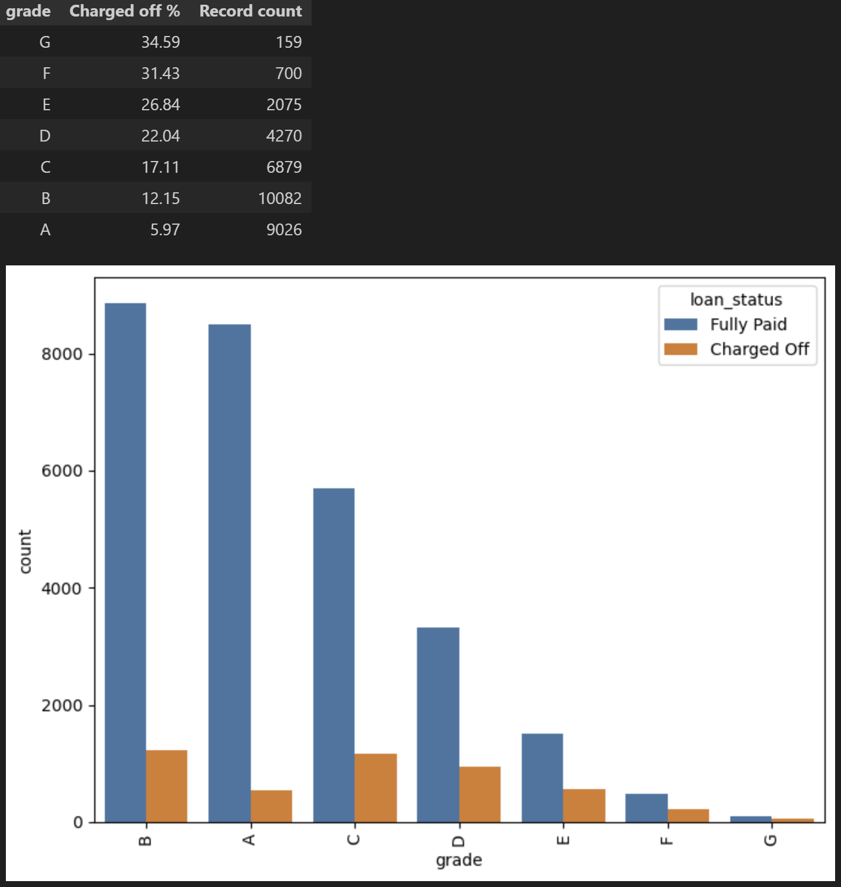
Loan Grades

Slide 25
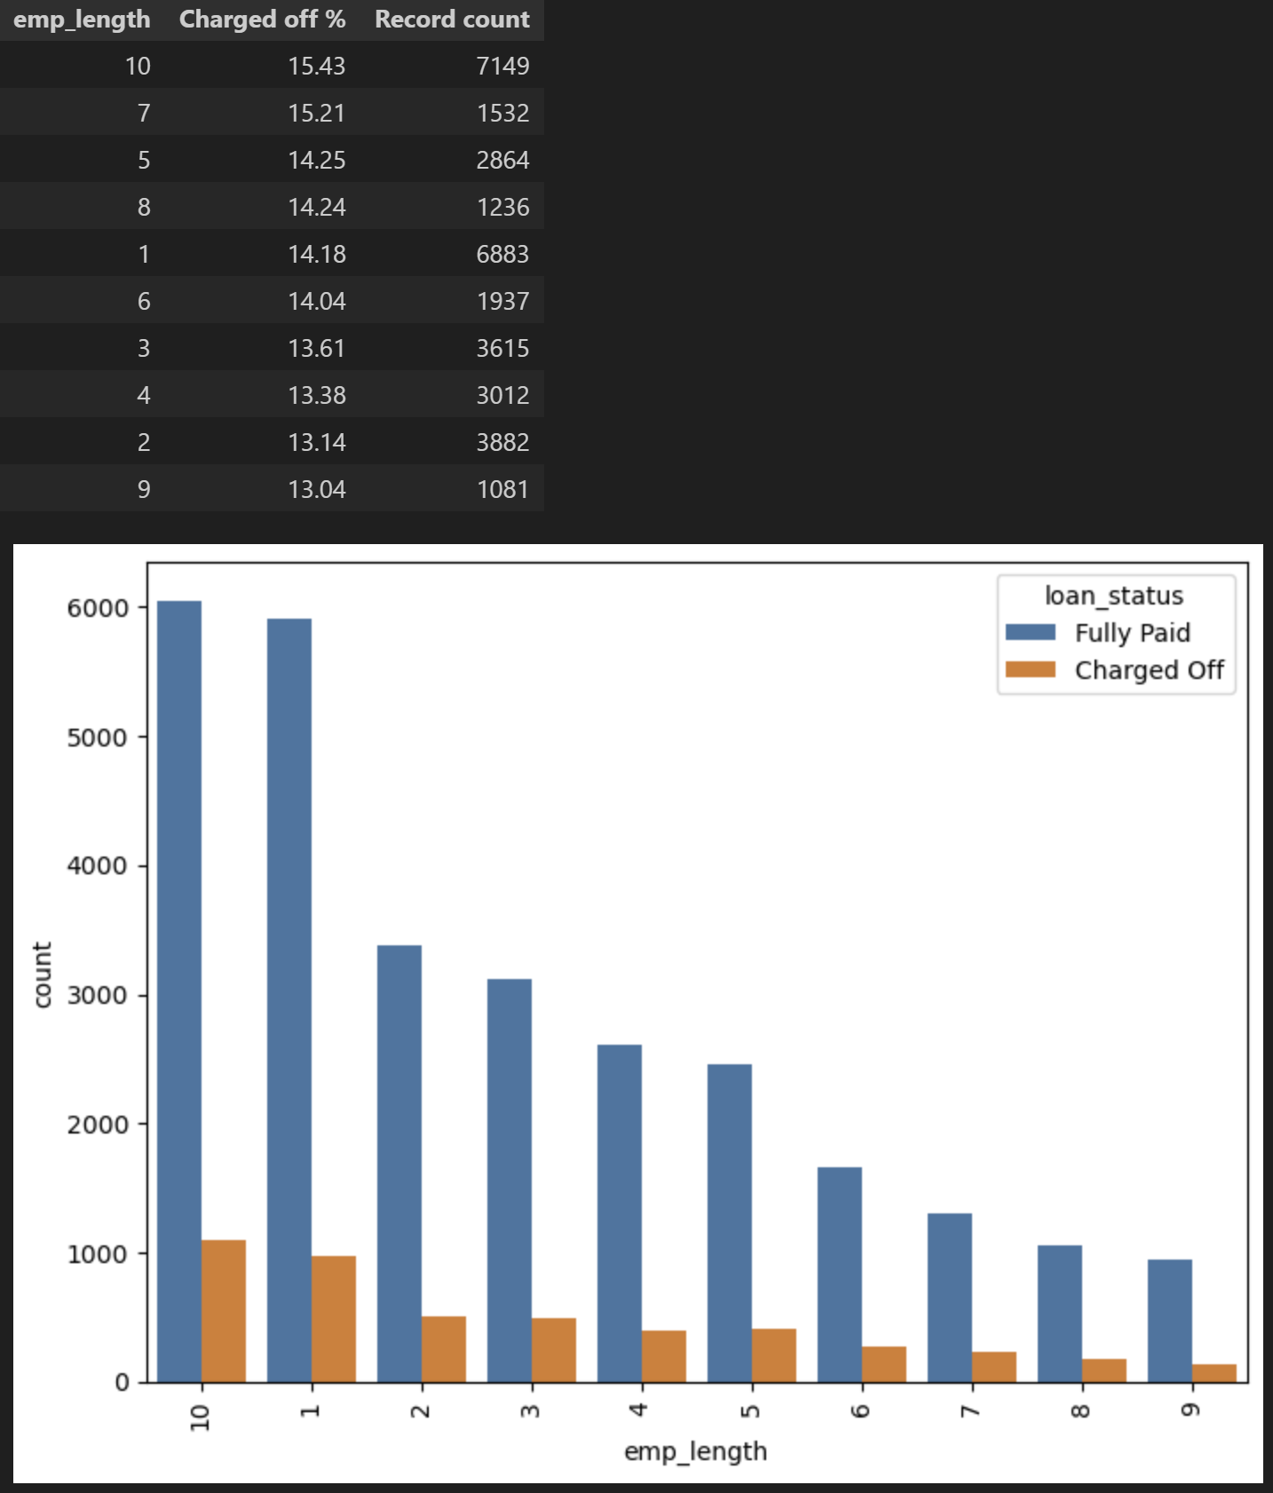
Employee Experience

Slide 26
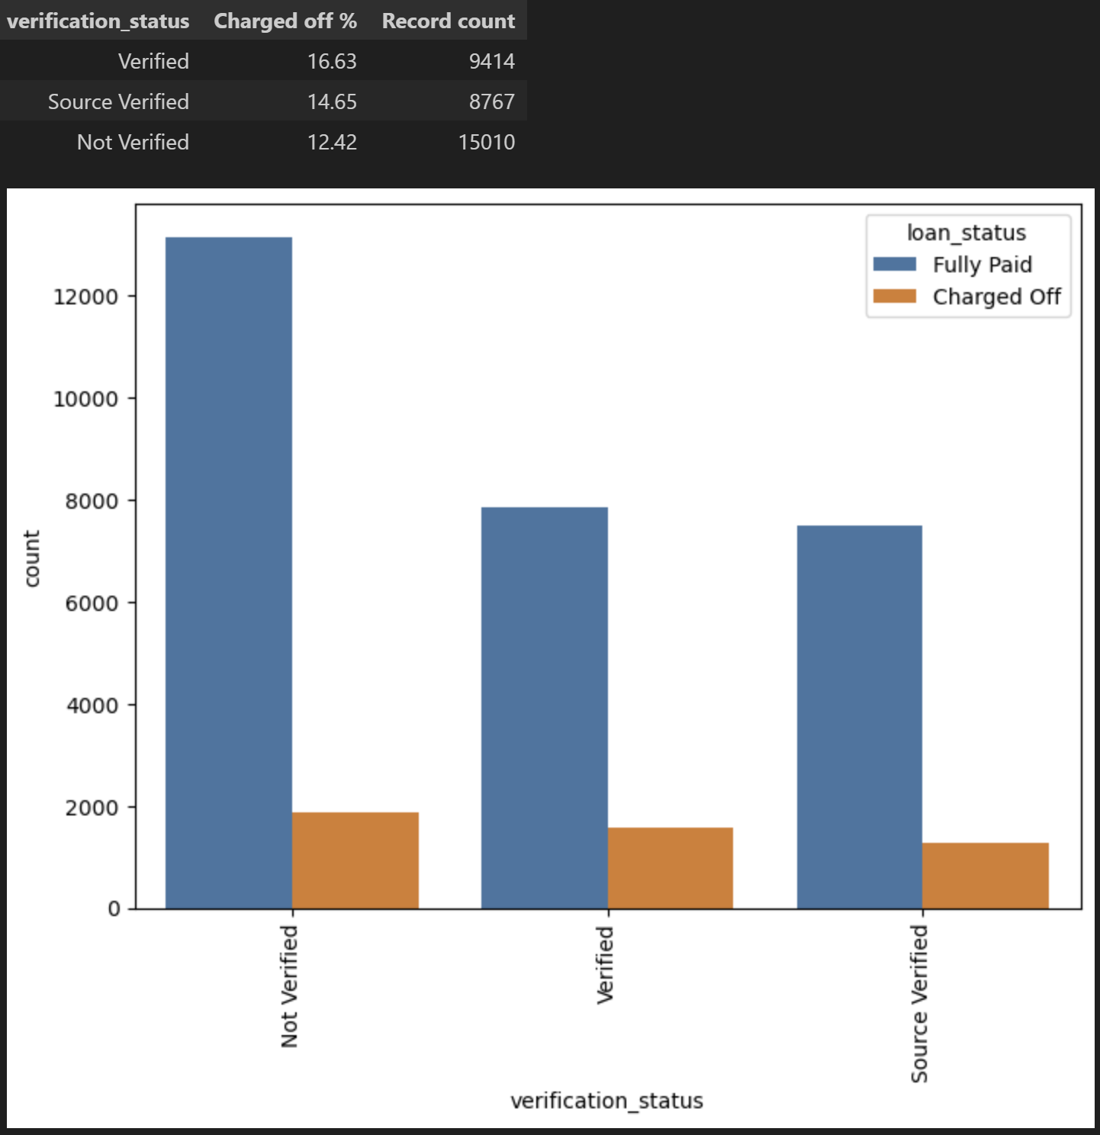
Verification Process

Slide 27
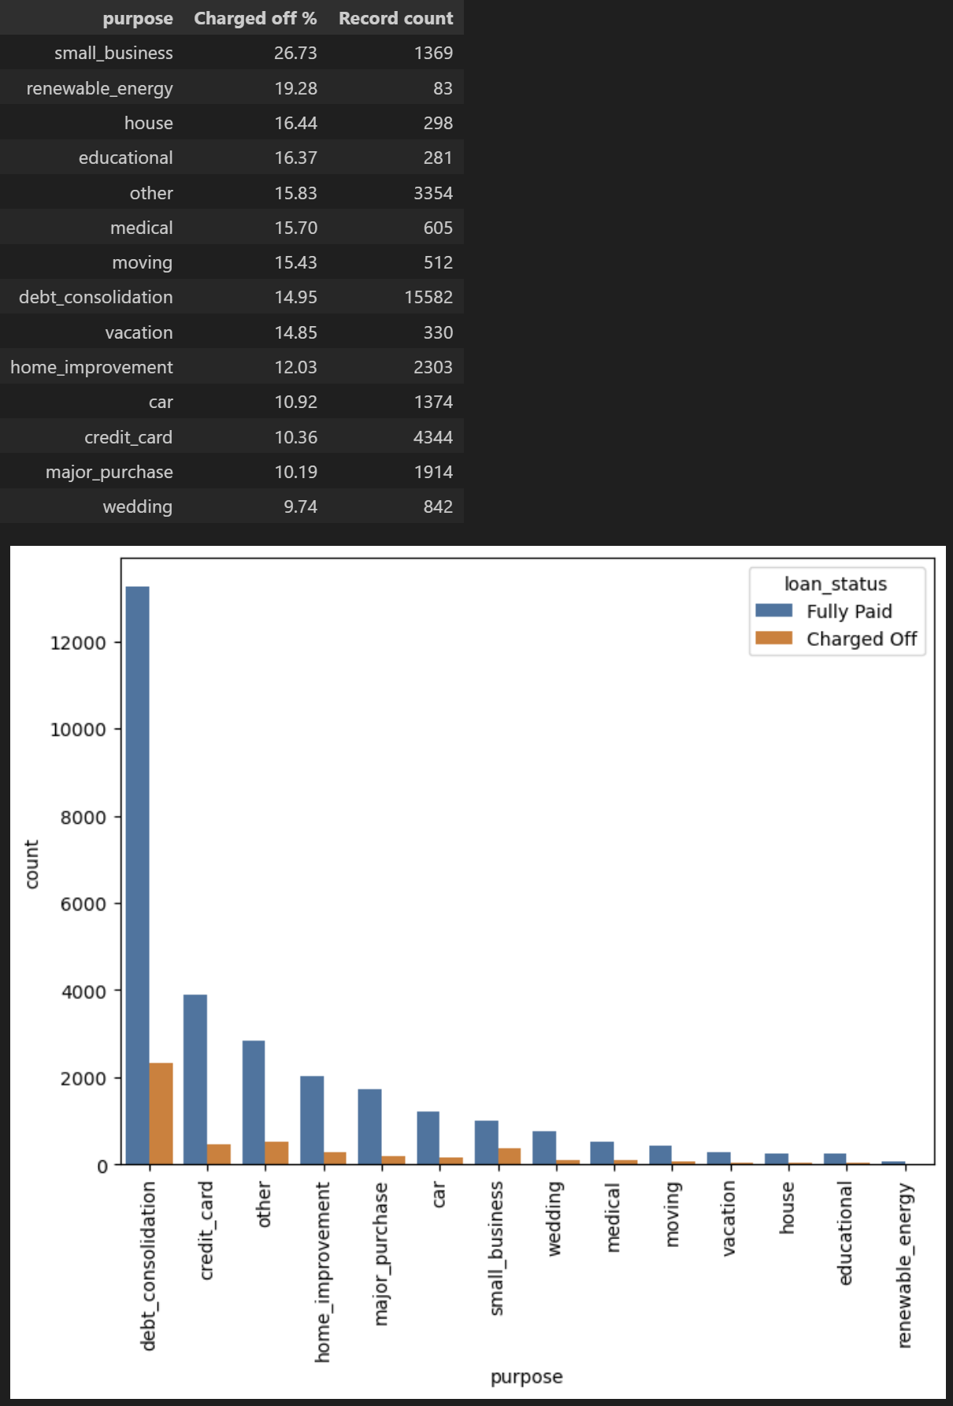
Purpose

Slide 28
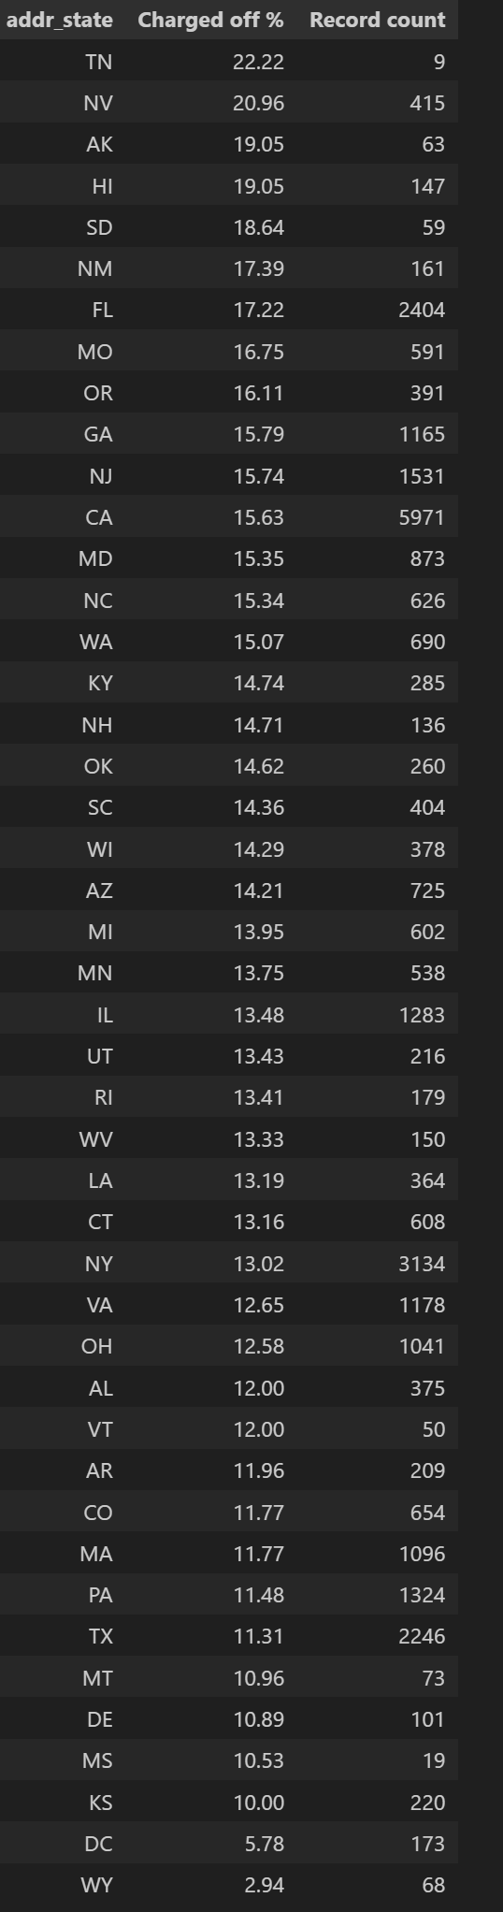
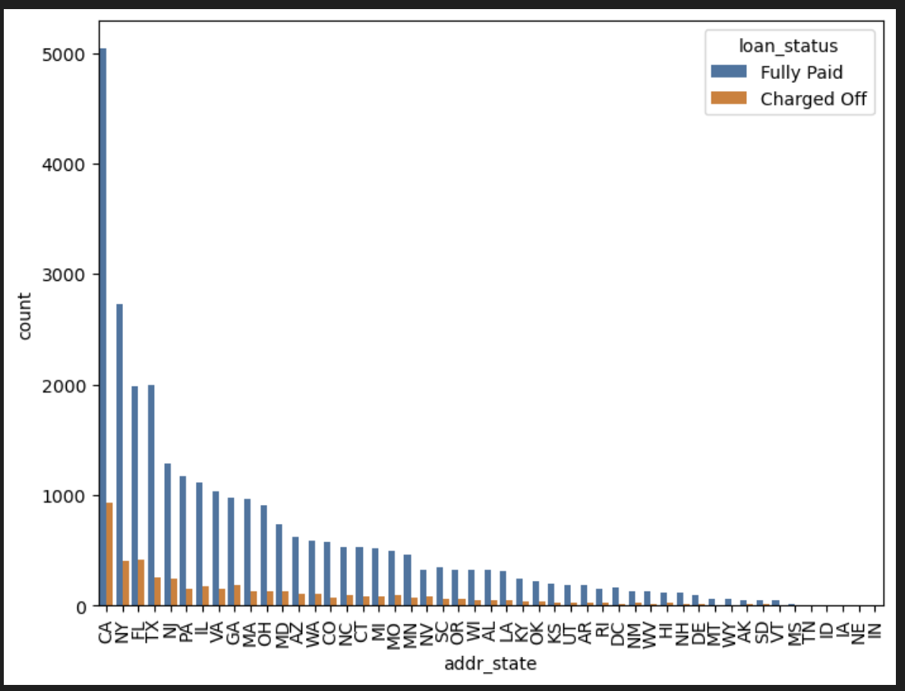
State-Specific Risk

Slide 29
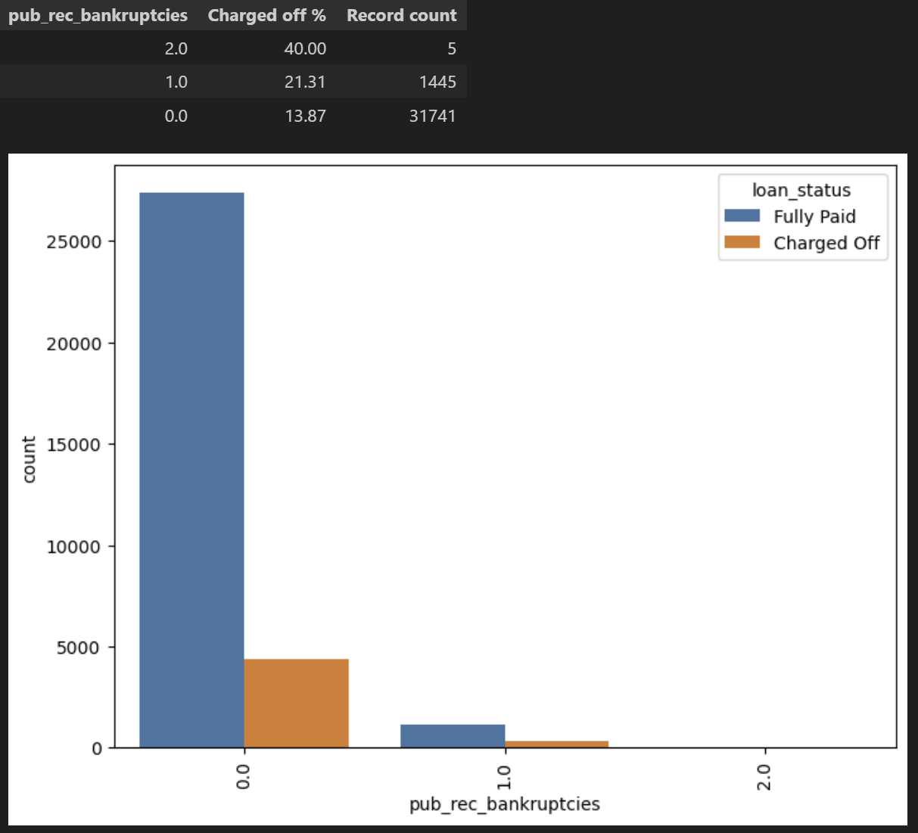
Bankruptcy

Slide 30
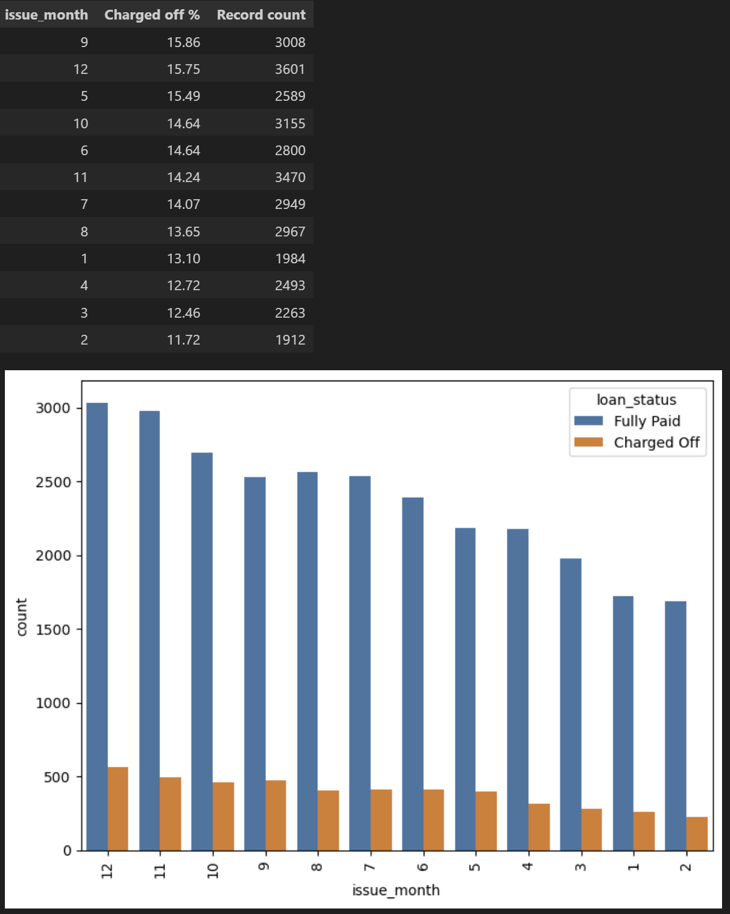
Loan Issuance by Month

